Slide 1



CYBER FOUNDATION & CTF MINDSET
CGH-X
MODULE 1 CLASS 3
Encoding, Crypto Basics & File Investigation
RECOGNIZE. DECODE. INVESTIGATE. VERIFY.
CyberHELP × FIRE Cybersecurity Community
Notes:
Welcome learners and set expectations for our first session together today. We are building real security skills from day one. Let us dive right in and get started.

Slide 2

MYSTERY MESSAGE
RW5jb2RpbmcgaXMgbm90IGVuY3J5cHRpb24=
What pattern do you notice before using a tool?
Decode the message before class begins.
Notes:
Instructor answer: Encoding is not encryption. Ask students to identify Base64 from its character set and trailing equals sign before decoding it.

Slide 3

TODAY'S MISSION
Learn the pattern. Then investigate.
Short theory. Two practical labs. One mini CTF.
PART 1 THEORY
PART 2 HANDS-ON
Recognize the transformation
Decode and verify evidence
Separate encoding, encryption, and hashing. Learn the visual clues.
Use CyberChef and Linux tools to follow clues—not guesses.
THEORY → DEMO → GUIDED LAB → CHALLENGE
0:00–0:08
Notes:
Introduce both communities and show how this journey supports absolute beginners. You do not need prior experience here. We learn by doing, together.

Slide 4

TODAY'S JOURNEY
One lesson. Six stages.
90 MINUTES · HANDS-ON
01
02
03
04
05
06
0:00–0:10
0:10–0:25
0:25–0:40
0:40–0:58
0:58–1:18
1:18–1:30
Mystery Decode
Three Core Concepts
Common Encodings
CyberChef Lab
File Investigation
Mini CTF & Review
Start with evidence
Know the difference
Learn visual clues
Decode step by step
Follow hidden evidence
Prove what you learned
Today: identify, decode, investigate, and document.
YOU ARE HERE → MODULE 1
0:00–0:08
Notes:
Walk through the roadmap across all 24 weeks to show the full journey. We start with absolute basics today and build step by step toward advanced security roles.

Slide 5

SECTION 01 FUNDAMENTALS
Know what transformation you are looking at.
Different goals demand different investigation methods.
TODAY'S CORE
COMPARE WITH
Encoding
Encryption + Hashing
Changes representation so systems can store or transmit data.
Encryption protects with a key; hashing creates a one-way fingerprint.
REVERSIBLE WITHOUT A SECRET
CONFIDENTIALITY + INTEGRITY
THE SIGNALS YOU WILL LEARN TO RECOGNIZE
ASCII
HEX
BASE64
URL
ROT13
HASH
Characters
0–9 + A–F
Often ends with =
%20 style
Letter shift
Fixed-length digest
0:08–0:25
Notes:
Explain the capture the flag format and our core challenge categories. This is how curiosity transforms directly into practical technical skill.

Slide 6
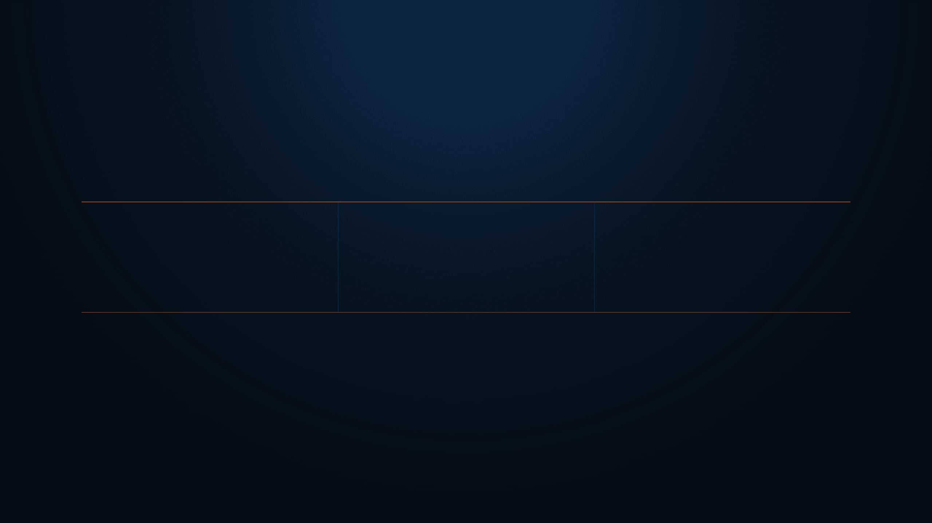
THE BIG DISTINCTION
Three operations. Three purposes.
Ask: can it be reversed, and does it need a key?
01
02
03
Encoding changes representation
Encryption protects secrecy with a key
Hashing creates a one-way fingerprint
RklSRXtub3Rfc2VjcmV0fQ==
Anyone can decode Base64. It is not protection.
0:08–0:25
Notes:
Security without ethics is just vandalism, and we draw that line right here. Never touch anything outside the authorized labs or share flags with peers. Establish ethics and lab boundaries clearly for the group before moving on.

Slide 7

RECOGNITION MAP
Eight clues before you touch a tool.
Observe characters, length, separators, and padding.
Base64
Hex
ASCII
URL
A–Z a–z 0–9 + / and =
Only 0–9 and A–F; often even length
Decimal character codes
Percent codes: %20 and %2F
ROT13
Caesar
Hash
Magic
Letters only; same length
Alphabet shifted by a key
Fixed-length hex digest
Helpful hint; verify it
RECOGNIZE FIRST. THEN DECODE DELIBERATELY.
0:25–0:40
Notes:
You don't need a hundred tools to start, just these eight core utilities. Master them on the command line right now. Demonstrate the eight commands live on screen so everyone sees them in action.

Slide 8

DOCUMENT THE CLUE
FILE_INVESTIGATION.md
KEEP IT SHORT · KEEP IT HONEST
Professionals record the path, not only the flag.
Input / filename:
What I observed:
A clean investigation note makes your reasoning visible and repeatable.
Encoding or file type suspected:
THIS IS YOUR HYPOTHESIS.
Tool or command:
Screenshot this slide.
Use this structure after every decoding task.
Verified output:
EVIDENCE > GUESSING
0:25–0:40
Notes:
If you didn't write it down, it never happened in security. Document your dead ends and failed attempts just as carefully as your wins. Model a concise writeup for the room using the template on screen.

Slide 9

ENCODING MAP
Six common CTF patterns.
Look at the alphabet and structure before using a decoder.
01 / BASE64
Base64
02 / HEX
Hexadecimal
03 / ASCII
ASCII
URL
Encoding
ROT13
06 / HASH
MD5 / SHA
04 / URL
05 / ROT
Caesar Shift
Fingerprint, not ciphertext
0:25–0:40
Notes:
Every puzzle you face breaks down into one of these six core domains. Notice how each category demands a different lens, but they all share a single habit: observe first, then test a hypothesis. Let's walk through these categories together and see what kind of problems we will solve.

Slide 10

THE TARGET
What a successful decode looks like.
FIRE{encoding_is_not_encryption}
A readable, meaningful result is evidence. Verify before submitting.
0:25–0:40
Notes:
This format is your ultimate objective on every single challenge you tackle. Let learners read the sample flag displayed on screen and notice the exact curly brace syntax. Every flag proves you cracked the system, and nothing else counts.

Slide 11

INVESTIGATION FIRST
The rules.
Treat the original data as evidence.
!
!
!
Preserve the original input
Do not trust automatic detection blindly
Verify that the output makes sense
Tools assist judgment. They do not replace it.
0:25–0:40
Notes:
Enforce scope strictly right from day one of your ethical hacking journey. Remember that your lab access is a privilege, so never share flags or scan systems outside your assigned environment. Permission is what separates an authorized defender from a criminal.

Slide 12

THE LINE THAT MATTERS
“Encoding changes appearance. Encryption changes who can read it.”
Base64 is useful—but it is not secrecy.
0:25–0:40
Notes:
Technical skill alone does not give you the right to break into any system you choose. Always keep written authorization in your back pocket before running any tool against a live target. That single legal boundary defines your entire career.

Slide 13

DECODING WORKFLOW
Preserve the original
The Five-Step Protocol.
01
Copy it exactly. Do not delete padding or spaces.
Observe the character set
02
Screenshot this slide. Use it whenever a clue looks unfamiliar.
Letters? Digits? Hex symbols? Percent signs?
Form one hypothesis
03
Example: “This looks like Base64.”
DO NOT RANDOMLY CLICK EVERY DECODER.
An investigator observes the pattern, forms a hypothesis, then verifies.
Decode with one deliberate operation
04
Use CyberChef or the correct command-line tool.
Verify the result
05
Readable text? Expected flag format? Repeatable method?
OBSERVE → HYPOTHESIZE → TEST → VERIFY → DOCUMENT.
0:25–0:40
Notes:
Model the stuck protocol explicitly so learners know exactly what to do when they hit a wall. Don't quit early, and don't spend four hours spinning your wheels in silence. Follow these five steps to turn frustration into real skill development.

Slide 14

SECTION 02 HANDS-ON PRACTICE
CYBERCHEF SURVIVAL
8 operations. One rule: know why you use each.
INPUT → RECIPE → OUTPUT
0:40–0:58
Notes:
Every security journey begins with the command line. We don't need a thousand commands to start, just eight solid ones. Type everything yourself in the lab, watch what happens, and repeat until it clicks. Instructor action: launch the Linux lab right now so everyone can log in.

Slide 15

CYBERCHEF SURVIVAL
The 8 operations.
That is enough for today's lab.
From Base64
From Hex
From Decimal
URL Decode
Decode Base64 text.
Decode hexadecimal bytes.
Convert ASCII number lists.
Convert %xx sequences.
ROT13
Magic
Entropy
SHA2
Rotate letters by 13.
Suggest likely operations.
Estimate randomness.
Create a verification hash.
DRAG ONE OPERATION. OBSERVE ONE RESULT.
0:40–0:58
Notes:
These eight commands are your basic toolkit for every challenge ahead. You check your location, peek at hidden files, read documents, and search inside binaries without getting lost. Instructor action: demonstrate commands like ls and cat live in the terminal for thirty seconds.

Slide 16

ANALYST THINKING
Why each operation matters.
The operation is useful only when the clue supports it.
CLUE
BEST FIRST MOVE
Ends with =
→
Try From Base64.
Only 0–9 and A–F
→
Try From Hex.
Contains %2F or %20
→
Try URL Decode.
32 or 64 hex characters
→
Treat as a possible hash; do not “decode.”
CHOOSE THE OPERATION FROM THE EVIDENCE.
0:40–0:58
Notes:
Knowing a command is useless without knowing why you are running it. Attackers use these specific tools to find hidden files, inspect binaries instantly, and search entire systems without wasting time. Instructor action: point out categories on the screen and explain how recon saves hours of frustration.

Slide 17

RESOURCE ALERT
!
DO NOT CLICK “MAGIC” FIRST.
Automatic detection is helpful, but you must explain why the output is believable.
USE MAGIC TO CHECK A HYPOTHESIS—NOT TO REPLACE ONE.
0:40–0:58
Notes:
Please do not launch your AttackBox right now. We only get limited free time each day, and we will need every minute of it when the actual lab starts soon. Hold off and stay with us.

Slide 18

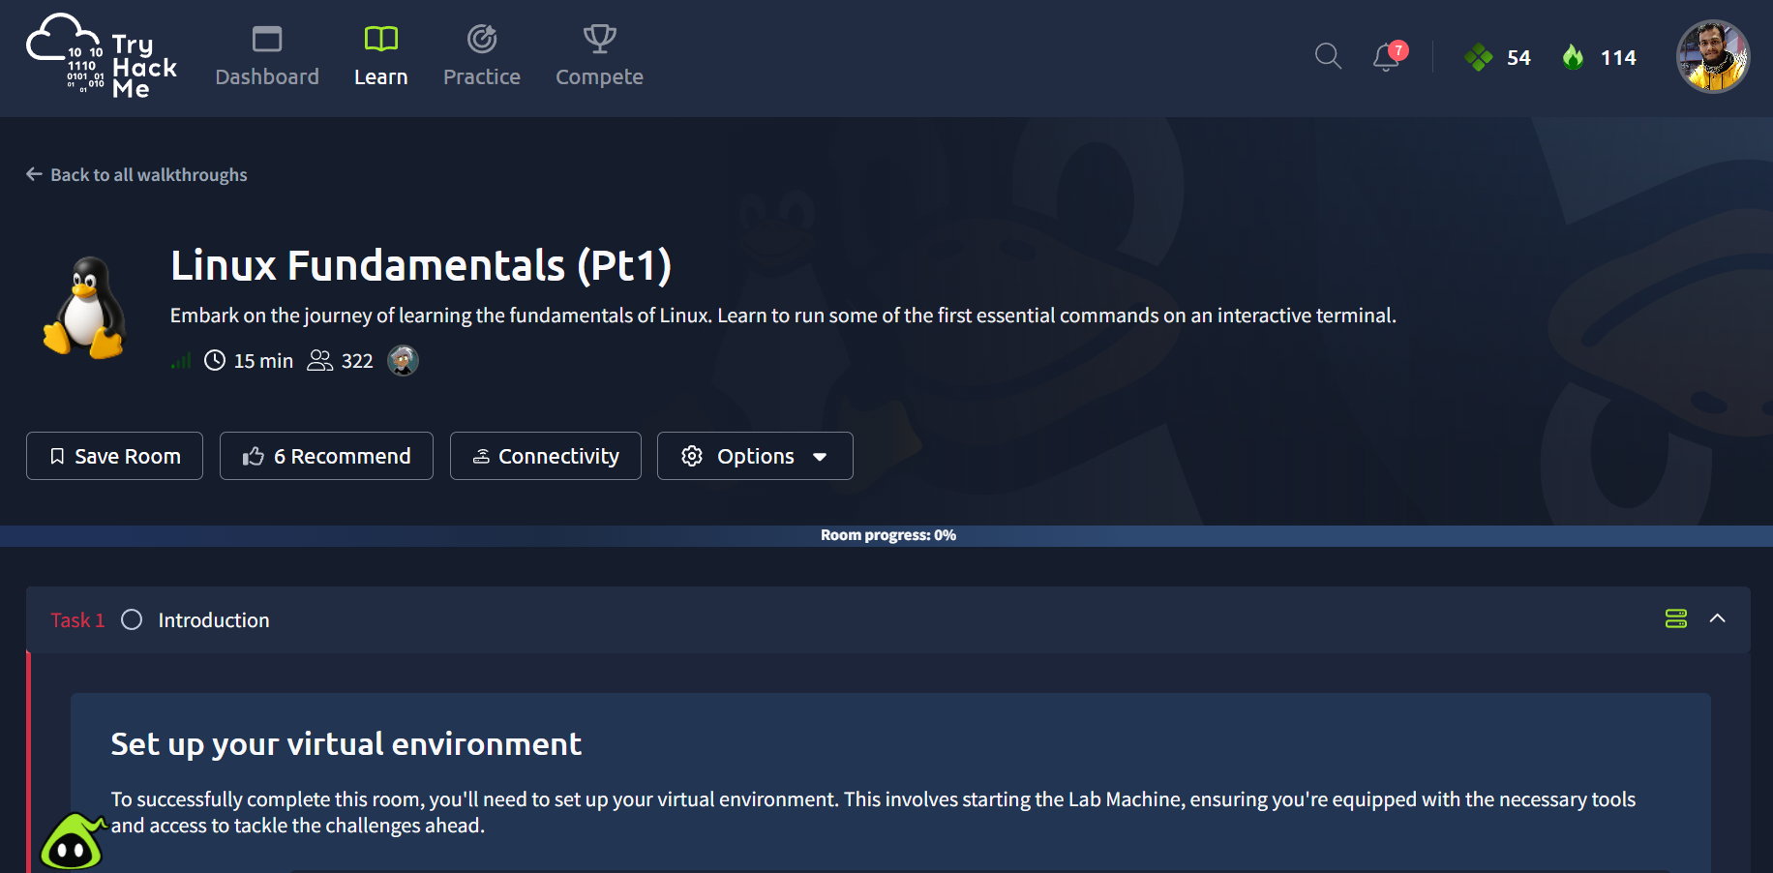
LAB 1 GUIDED PRACTICE
CYBERCHEF
TryHackMe → CyberChef: The Basics
INPUT
RECIPE
OUTPUT
U0VDUkVUX0ZMQUc=
From Base64
SECRET_FLAG
Recognize the pattern. Build the recipe. Verify the result.
01
Open the room and the CyberChef workspace.
Recognize → Build recipe → Verify
02
Complete Base64, Hex, and ROT13 tasks.
03
Record the recipe that produced each answer.
RULE: Explain the clue before you decode.
0:40–0:58
Notes:
Official room: https://tryhackme.com/room/cyberchefbasics
Instructor flow: demonstrate one example, then let students complete Base64, Hex, and ROT13 tasks independently.

Slide 19

SECTION 03 LIVE PRACTICE
YOUR FIRST DECODE
Everyone. Own hands. Explain the clue.
NO GUESS / NO MAGIC FIRST / VERIFY THE OUTPUT
0:58–1:18
Notes:
Every single one of you needs to complete this next task with your own hands right now. Drop the mouse and listen closely. We are not copying code and we are not guessing. Let's find that first flag together.

Slide 20

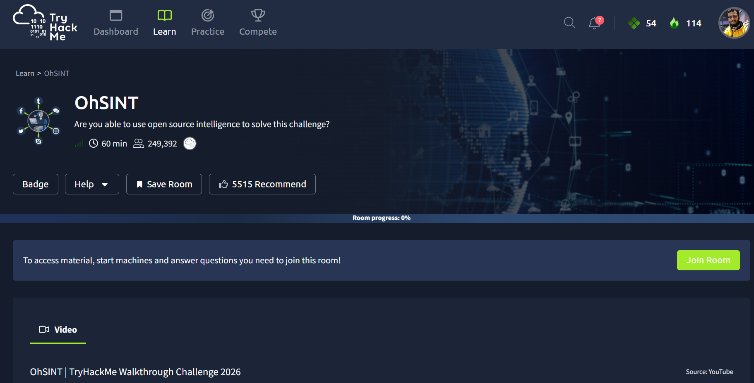
LAB 2 FILE INVESTIGATION
student@lab:~/class3_evidence
Local Evidence Pack
$ sha256sum evidence.dat
$ file *
$ strings evidence.dat | grep -i flag
$ xxd clue.txt
$ printf '%s' '46495245' | xxd -r -p
Use Linux tools to identify, inspect, and decode hidden data.
01
Run file * before opening anything.
02
Use strings and grep to search readable clues.
IDENTIFY → INSPECT → DECODE → VERIFY
03
Use xxd to inspect bytes; hash evidence before and after.
RULE: Preserve the evidence. Record every command.
0:58–1:18
Notes:
Prepare a ZIP with message.txt, mystery.jpg, data.bin, clue.txt, and evidence.dat. Students should start with sha256sum and file, then use strings, grep, and xxd. Replace xxd with od/hexdump if the lab image lacks xxd.

Slide 21

STRETCH CHALLENGE
LAYER
CAKE
Start with the visible character pattern.
01
Finished early? Decode all three layers.
02
Decode only one layer at a time.
A single clue has been transformed more than once. Identify the outer layer, decode it, then repeat until the flag appears.
Write the complete recipe.
Every layer must be explained.
03
NTM1NjQ1NTI3YjY3NzU2NTcyNzI1Zjc5NmU2YzcyNjU2Njdk
0:58–1:18
Notes:
Instructor-only solution: From Base64 → From Hex → ROT13 → FIRE{three_layers}. Ask students to justify every layer from the visible pattern.

Slide 22

SECTION 04 PROFESSIONAL HABITS
VERIFY IT
A result is not reliable until the method is repeatable.
TURN YOUR RECIPE INTO EVIDENCE.
1:18–1:24
Notes:
Documenting your journey is what separates an amateur hobbyist from a true professional in the field. Let us look at how recording your exact steps builds undeniable evidence of your learning process.

Slide 23

WRITE IT DOWN
INVESTIGATION.md
KEEP IT SHORT · KEEP IT HONEST
The investigation template.
Input / filename:
A clean writeup makes your reasoning visible—to you, your team, and your future employer.
What I observed:
Transformation / file type suspected:
THIS IS YOUR HYPOTHESIS.
Screenshot this slide.
Use this structure after every challenge.
Tool or command:
Verified output:
EVIDENCE > MEMORY
1:18–1:24
Notes:
Let us model the writeup format using a clean, repeatable structure that captures both your successes and your failures. Take a snapshot of this layout because every professional report relies on this exact evidence.

Slide 24

BEFORE NEXT CLASS
YOUR CHECKLIST
Homework.
□
Finish TryHackMe: CyberChef The Basics
REQUIRED
Practice recognition and decoding while the clues are still fresh.
□
Solve the instructor evidence pack
REQUIRED
ROUGHLY 90 MINUTES
OF FOCUSED WORK.
□
Write 2 investigation writeups
REQUIRED
□
TryHackMe: Cryptography Basics
OPTIONAL
POST YOUR WRITEUPS IN THE GROUP. Show the clue, recipe, output, and verification.
1:24–1:28
Notes:
Required: https://tryhackme.com/room/cyberchefbasics
Optional extension: https://tryhackme.com/room/cryptographybasics
Submission: two concise investigation writeups with observation, hypothesis, tool/command, output, and verification.

Slide 25

COMMUNITY PROGRESS
THE SCOREBOARD IS LIVE.
LIVE EDITABLE TABLE
Complete the labs. Record the evidence. Move up together.
RANK
NAME
CHALLENGES COMPLETED
01
[ Arman ]
[ 10+20+10+10+15+15 ]
02
[ shawon ]
[ 10+15+10+15 ]
03
[ shibly ]
[ 10+20+20+20+20 ]
04
[ mazhar ]
[ 10+10+15+10 ]
UPDATED AFTER EVERY CLASS.
1:24–1:28
Notes:
We see our progress tracking live right here on screen as points come in from our labs. And building skills together means watching how everyone moves up through the ranks. So update the leaderboard after every class to keep the momentum going as we tackle these challenges.

Slide 26

CLASS 4 SIGNAL
dmlldy1zb3VyY2U=
This is not encrypted. The browser is showing you a clue.
Next class: web basics, source code, cookies, and hidden paths.
DECODE THE CLUE.
1:28–1:30
Notes:
That coded string on screen is waiting for you to decode before our next session. But we're preserving the base64 reveal for Class 2 to show you how easy it is to read. So decode the clue and see what it actually tells you.

Slide 27

CLASS 3 COMPLETE
SEE YOU NEXT CLASS
founder@cyberhelpasia.com
WhatsApp: 01977667197
CyberHELP × FIRE Cybersecurity Community
Thank you for investigating carefully and documenting the evidence.
RECOGNIZE. DECODE. VERIFY.
Notes:
Thank you for showing up and building your cybersecurity foundations with us today. Remember to reach out on WhatsApp or email if you have questions about the lab. And we'll officially close the class here until next time.

